Slide 1
EMPLOYEE PERFOMANCE PREDICTION MODEL USING MACHINE LEARNING
By : LUCY WANJIRU NJENGA
15/08/2024

Slide 2
INTRODUCTION
PROJECT
Employee performance Prediction.
OBJECTIVE
Using Machine Learning to predict Employee Performance to assist the company in making more accurate hiring decisions and automating the process.
DATASET
INX Future Inc.

Slide 3
PROBLEM STATEMENT
The primary goal is to assist the company in making more accurate and consistent hiring decisions by predicting whether the employee is likely to perform well or not.
I will use the provided dataset: INX_Future_Inc_Employee_Performance_CDS_Project2_Data_V1.8.csv
Using the given historical dataset, the model can help identify applicants who are more likely to perform well for a given position in the company.

Slide 4
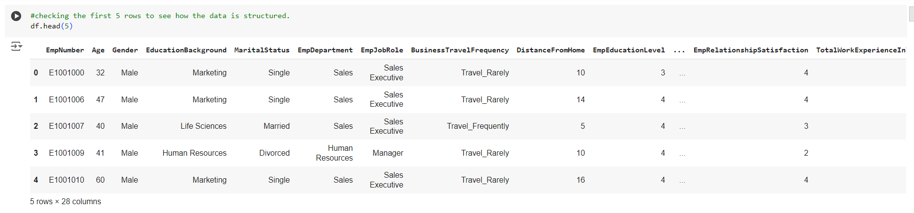
EXPLORATORY DATA ANALYSIS (EDA)

Slide 5
EDA
Started by loading the data set in Google Colab and performing Exploratory Data Analysis to see how the data is structured as the image shown above.
The dataset has 28 columns ,9 which contain categorical data and 19 containing numerical dataset.
The table above shows the first five rows of the dataset, but there are 1200 rows and 28 columns.

Slide 6
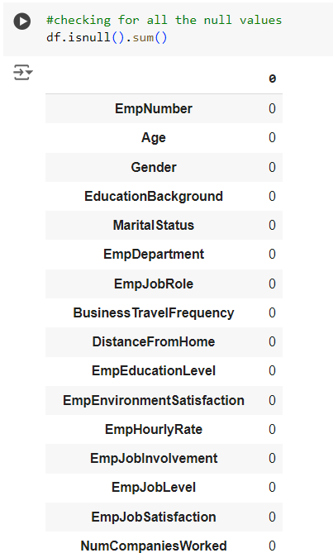
EDA

Slide 7
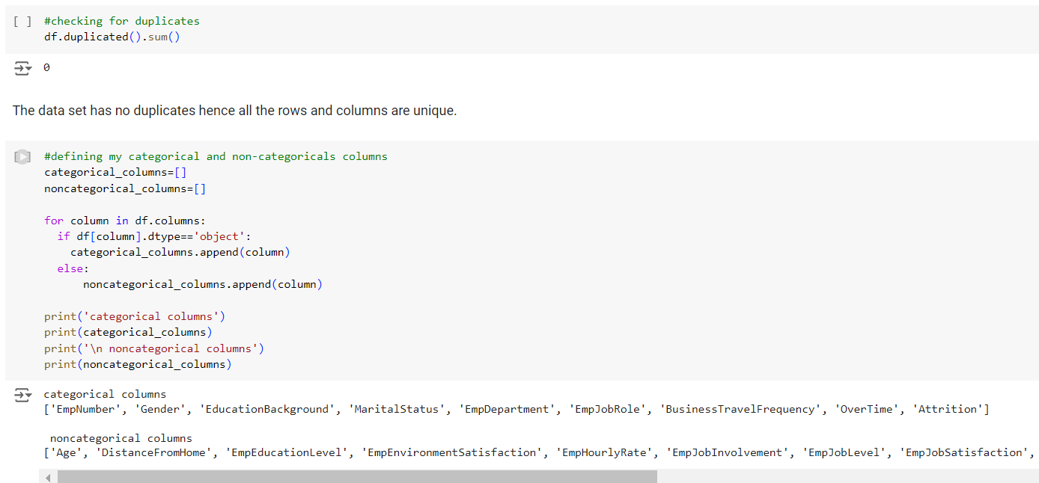
EDA

Slide 8
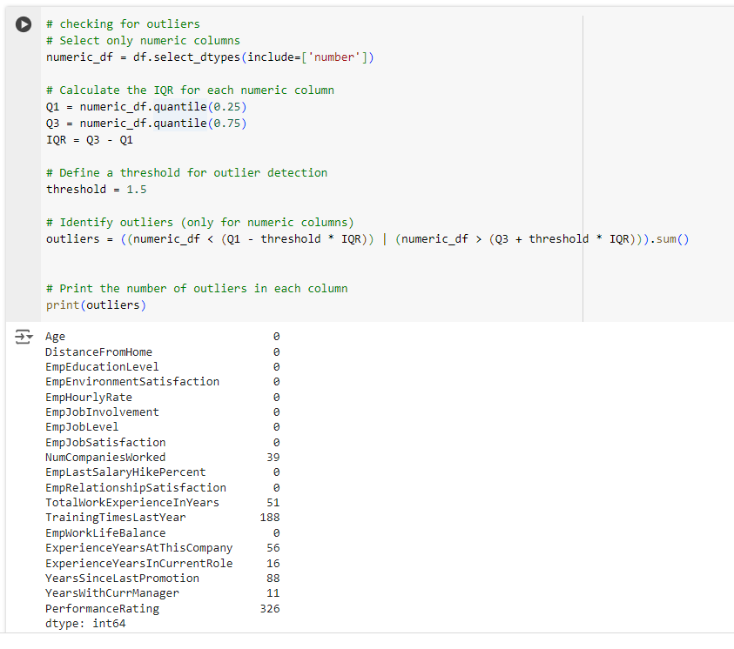
EDA

Slide 9
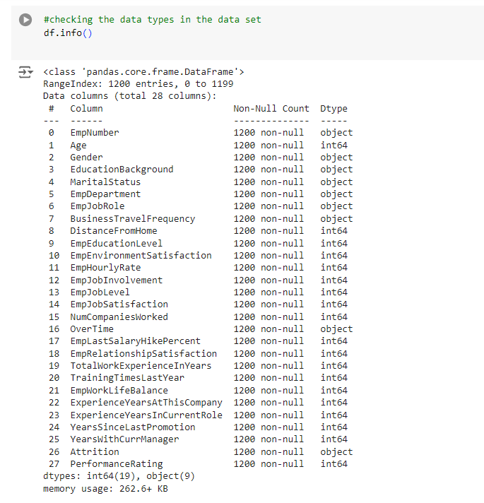
EDA

Slide 10
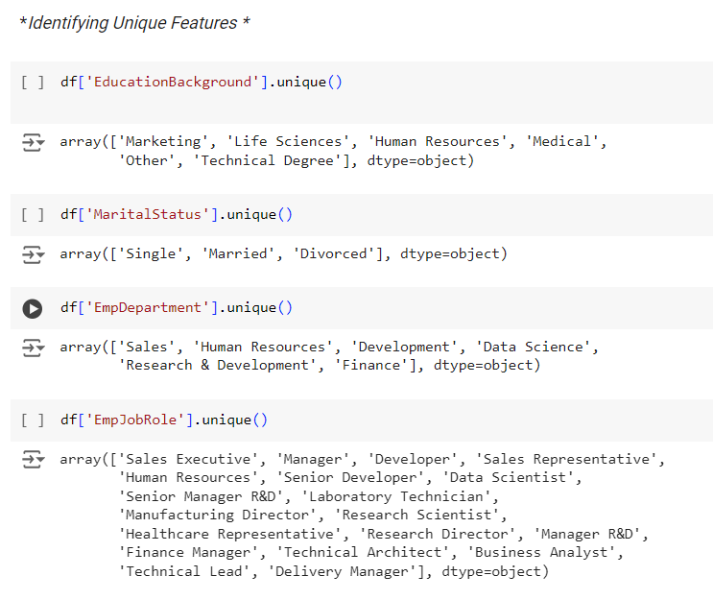
EDA

Slide 11
EDA EXPLANATION
I checked for duplicates, null values ,outliers to ensure that the data set is clean ,checked for the data types in the data set and defined the categorical columns and non-categorical columns .
Although the dataset contains outliers, I chose not to remove them as they provide valuable insights for the analysis.
The tables above shows that the dataset has no duplicates, null values and the data types in the dataset.
Checked for Unique features in different columns to check how different columns are structured.

Slide 12
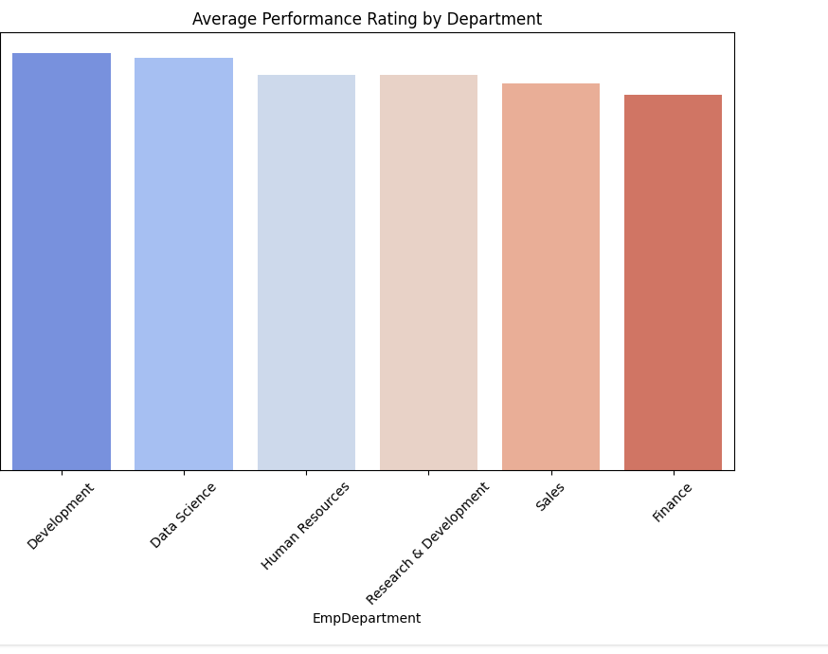
VISUALIZATIONS
Top-Performing Departments:
Departments like Development and Data Science have higher average performance ratings, indicating strong overall performance.
Low-Performing Departments:
Departments like Sales and Finance have lower average performance ratings, which might indicate issues with management, employee engagement, or resource allocation.

Slide 13
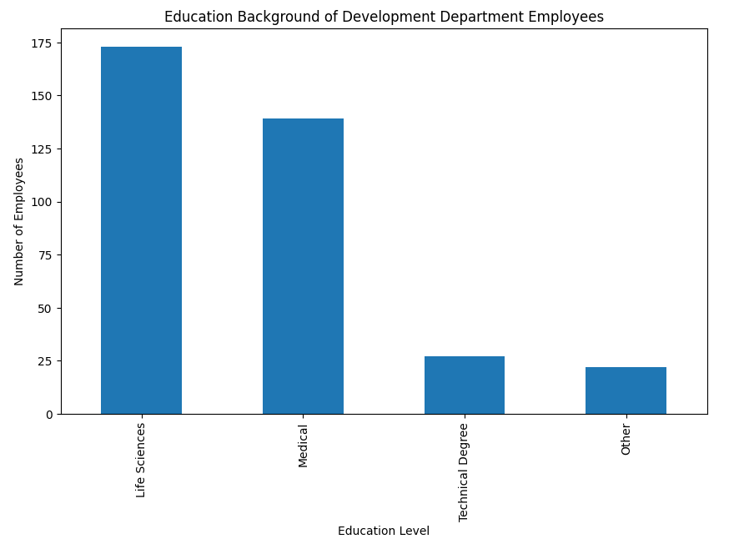
Education Background of the Best performing Department.
The Development department appears to heavily rely on employees with strong backgrounds in Life Sciences and Medical fields. This might reflect the nature of work in the department, which could involve research, development in healthcare, or biotechnology areas. Technical degrees and other backgrounds are less common, indicating more niche roles that require specific technical skills or diverse experiences.

Slide 14
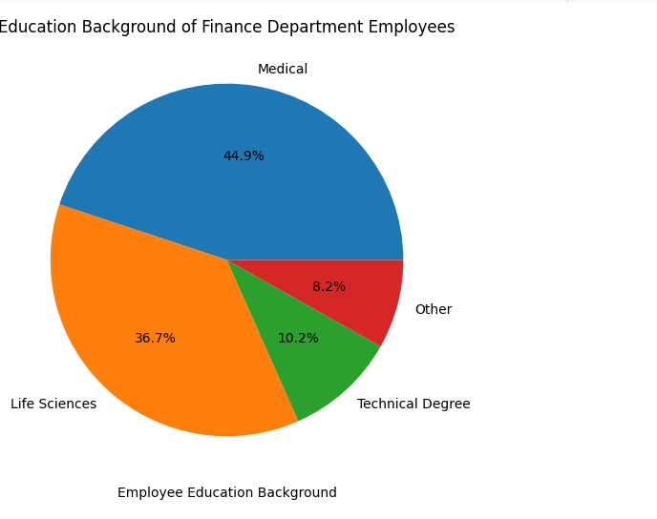
Education Background For the Least Performing Department
The majority of employees in the Finance department have a background in Medical and life science education backgrounds while the rest have technical degrees and other education background.
This might be a good indicator why the Finance department is performing poorly

Slide 15
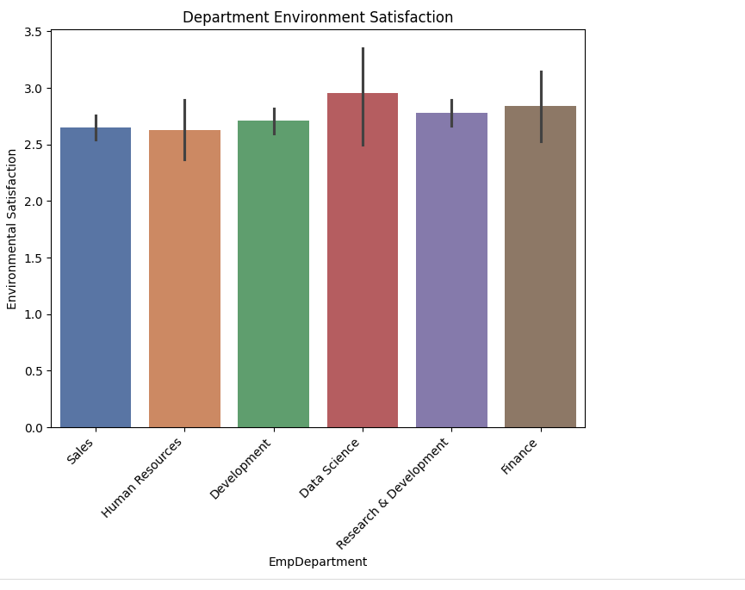
Departmental Average Ratings on Environmental Satisfaction.
Employee Environmental Satisfaction is positively Correlated with the performance.
The employee Environmental Satisfaction average rating in all the department is below 'High' hence many are between Medium and High ,hence indicating a gap in the working environment.

Slide 16
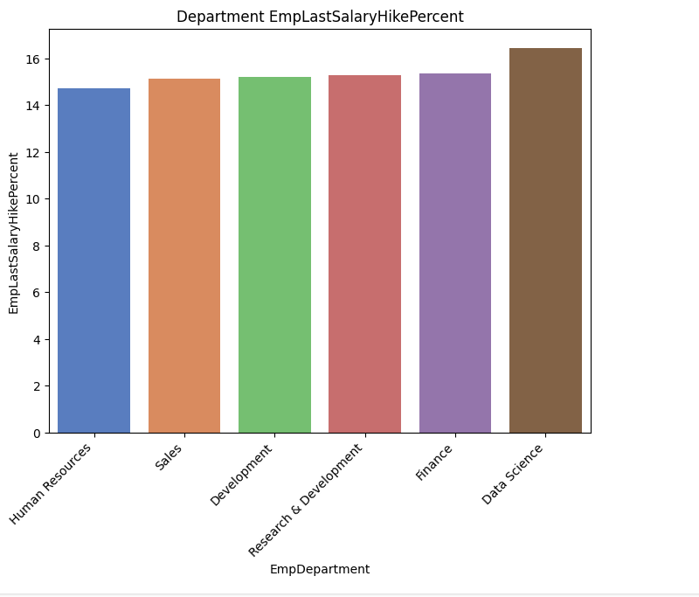
Employee Last Salary Hike Percent as per the Department.
The percentage of the last salary hike is positively correlated with performance.
Employees who receive higher salary increases may be more motivated and perform better.
The Data Science Department is one of the best performing department and they have a high salary hike percent and their environmental satisfaction is among the top hence showing a correlation as to why they are performing so well.

Slide 17
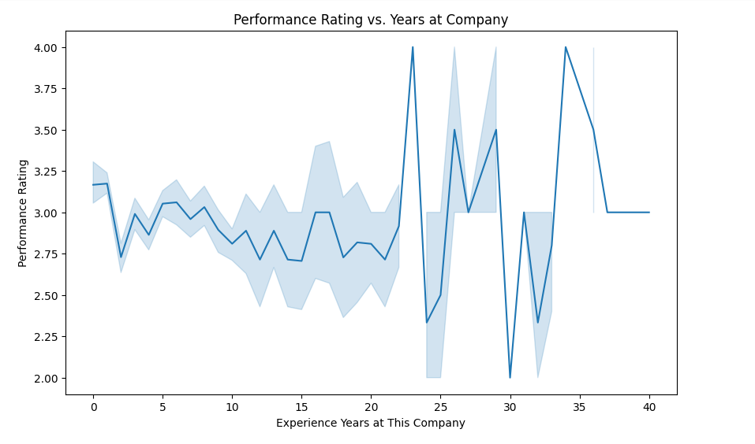
Performance Rating Vs Years at the Company
The line plot suggests there isn’t a strong correlation between the number of years at the company and performance rating, as performance ratings are scattered across all experience levels.
However, there might be a slight concentration of higher performance ratings for employees with 5-15 years of experience, indicating that mid-career employees may be performing well.
The lack of a strong correlation suggests that tenure alone doesn’t determine performance, so the company should focus on other factors.

Slide 18
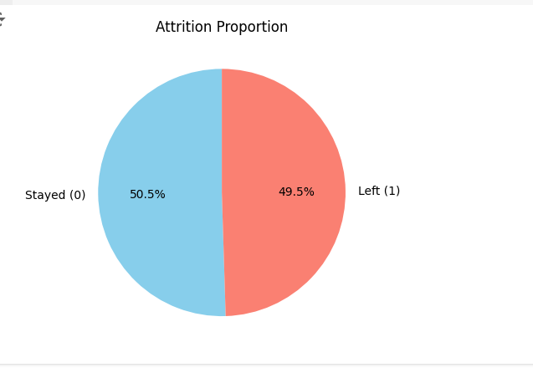
Attrition Impact on Performance
The pie chart compares the distribution of performance ratings between employees who have left the company (Attrition = 1) and those who have stayed (Attrition = 0).
For employees who stayed, the distribution is slightly more than those who left, though there is no big difference ,this shows attrition does not have a strong correlation with performance.

Slide 19
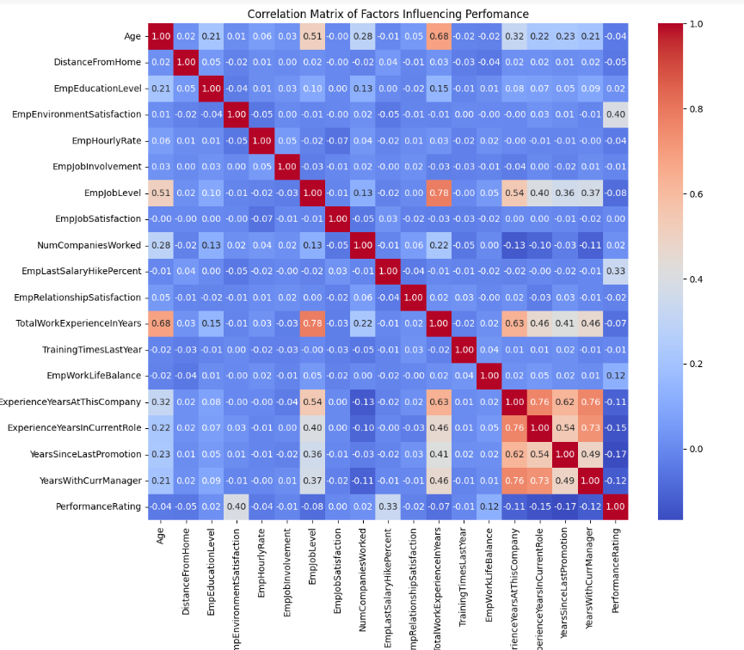
Correlation Matrix

Slide 20
Correlation Matrix
The heatmap displays the correlations between various factors, helping you identify which ones are strongly related to employee performance.
Employee Environment Satisfaction (Correlation: 0.40)
Employee satisfaction with their work environment is the strongest predictor of their performance. Enhancing the work environment can lead to better performance.
Employee Last Salary Hike Percent (Correlation: 0.33)
The percentage of the last salary hike is positively correlated with performance. Employees who receive higher salary increases may be more motivated and perform better.
Employee Work Life Balance(correlation:0.12) and Employee Education Level(correlation:0.02) have a weaker, but still notable, correlation with performance. Employees with a higher Education Level, balance the work life balance and do not work on overtime would perform well.

Slide 21
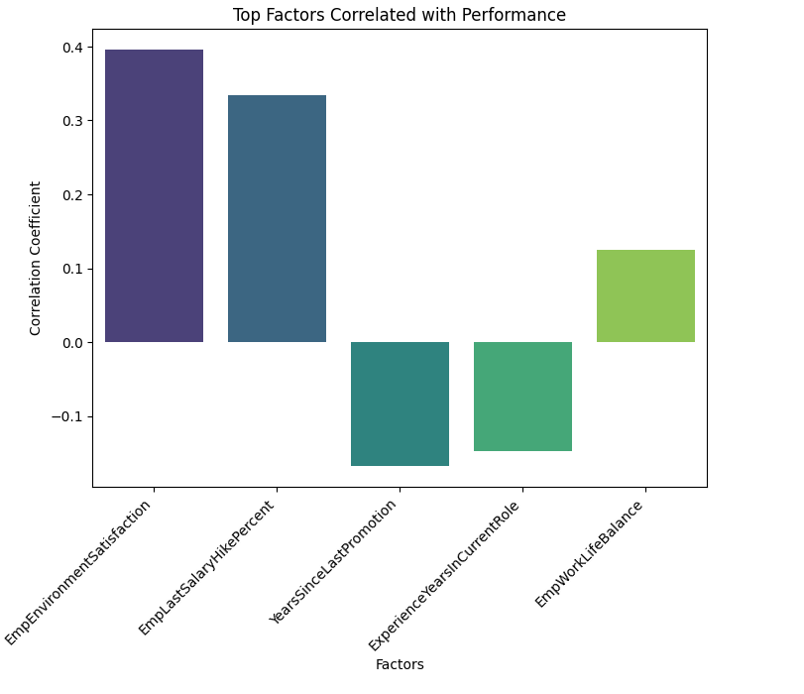
Top factors affecting performance based on correlation
A bar chart displaying some top factors that have the strongest correlation with performance ratings.
The values range from -1 to 1, where 1 indicates a perfect positive correlation, -1 indicates a perfect negative correlation, and values close to 0 indicate little or no correlation.
Environmental satisfaction, Employee last salary hike percent and Employee work life balance have a positive correlation with performance.

Slide 22
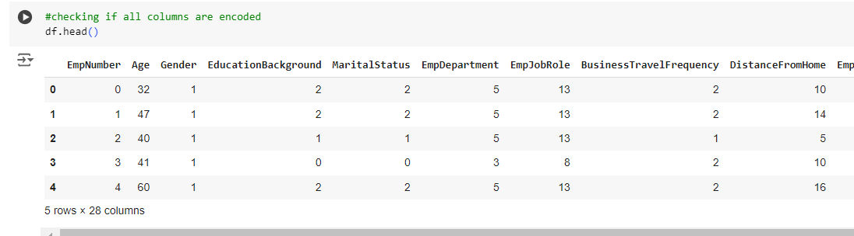
FEATURE ENGINEERING
Encoded the categorical columns using Label Encoder to numerical data since machine learning models do not take data inform of string.
Defined a function to create a new column Performance Category to map performance ratings to categories for classification model.
The tables below shows the encoded columns and the new created column.

Slide 23
EVALUATING THE ACCURACY OF DIFFERENT MODELS USED IN CLASSIFICATION.
Evaluated the accuracy score ,F1 score , Precision Score and Recall score of the Random Forest Classifier.
Defined the X which are the features used to predict the Y and the Y which is the target variable(Performance Rating).
Divided the data into 80% training data and 20% testing data and a random state of 42.
I did fit the different models with the training data that is (X-train, Y-train) and also fitted the model with the testing data (X-test) to predict the Y.
The scores were as follows:
Precision-score: 0.94
Recall-score: 0.87
F1-Score: 0.90
Accuracy-score: 0.94
The process is shown in the table below.

Slide 24
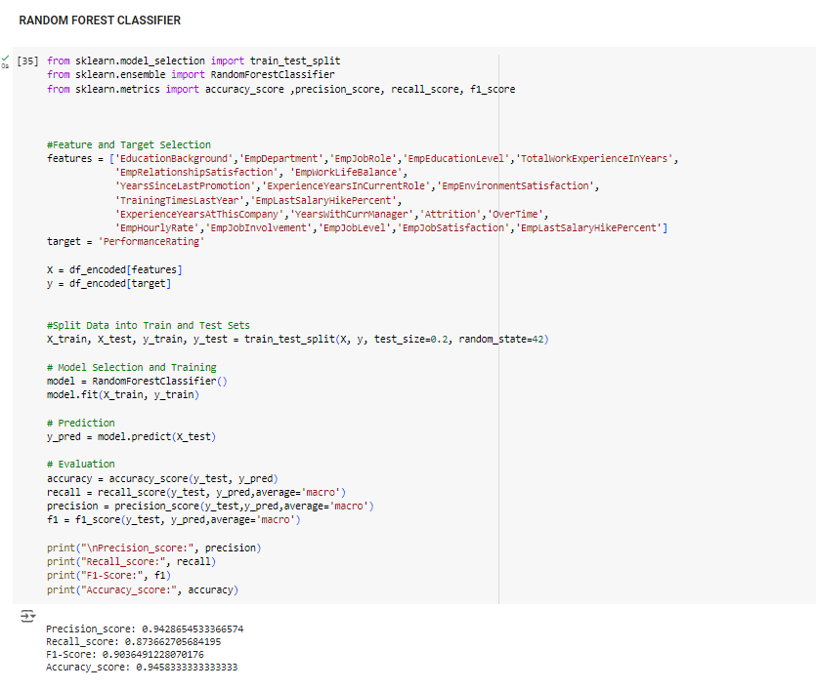
RANDOM FOREST CLASSIFIER

Slide 25
LOGISTIC REGRESSION
Evaluated the Accuracy score ,F1 score , Precision Score and Recall score of the Logistic Regression.
Defined the X which are the features used to predict the Y and the Y which is the target variable(Performance Rating).
Divided the data into 80% training data and 20% testing data and a random state of 42.
I did fit the different models with the training data that is (X-train, Y-train) and also fitted the model with the testing data (X-test) to predict the Y.
The scores were as follows:
Precision-score: 0.93
Recall-score: 0.85
F1-Score: 0.88
Accuracy-score: 0.93
The process is shown in the table below.

Slide 26
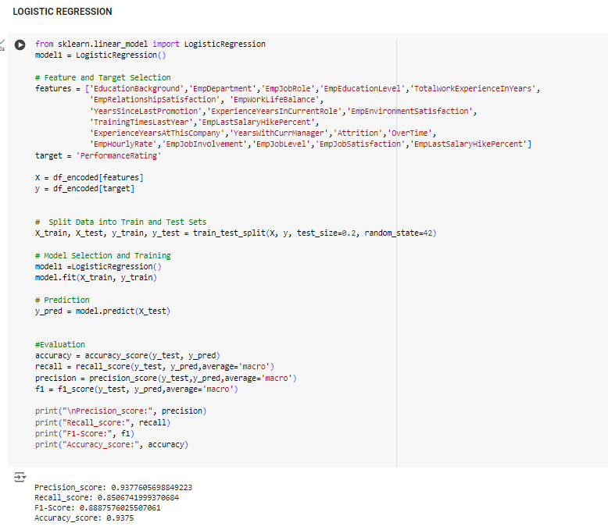
LOGISTIC REGRESSION

Slide 27
DECISION TREE CLASSIFIER
Evaluated the Accuracy score ,F1 score , Precision Score and Recall score of the Decision Tree Classifier .
Defined the X which are the features used to predict the Y and the Y which is the target variable(Performance Rating).
Divided the data into 80% training data and 20% testing data and a random state of 42.
I did fit the different models with the training data that is (X-train, Y-train) and also fitted the model with the testing data (X-test) to predict the Y.
The scores were as follows:
Precision-score: 0.94
Recall-score: 0.87
F1-Score: 0.90
Accuracy-score: 0.94
The process is shown in the table below.

Slide 28
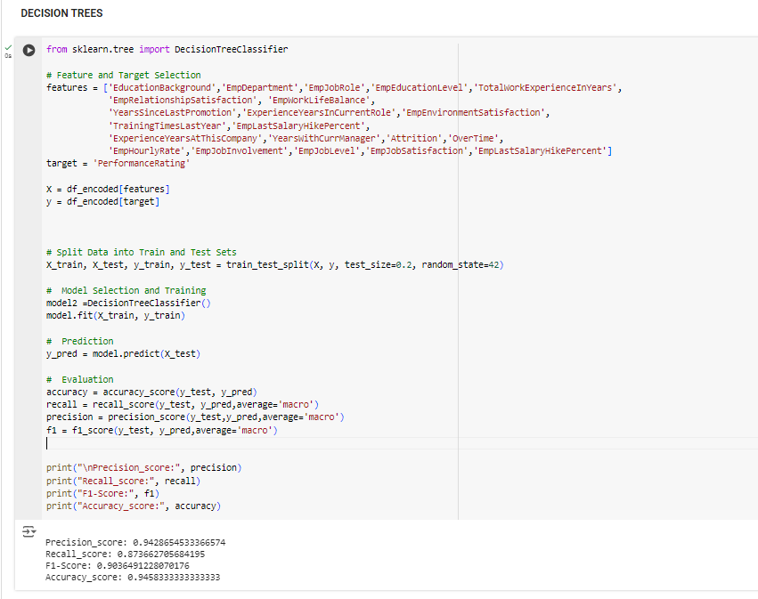
DECISION TREE CLASSIFIER

Slide 29
MODEL PERFOMANCE AND SELECTION
Accuracy: Random Forest and Decision Tree both have a slightly higher accuracy (0.94) compared to Logistic Regression (0.93).
Precision: Random Forest and Decision Tree also lead in precision with a score of 0.94, slightly higher than Logistic Regression’s 0.93.
Recall: Random Forest and Decision Tree perform better in recall as well (0.87 vs. 0.85 for Logistic Regression).
F1-Score: The F1-Score, which balances precision and recall, is higher for Random Forest and Decision Tree (0.90) compared to Logistic Regression (0.88).
Conclusion:
Random Forest and Decision Tree are performing similarly and better than Logistic Regression in all metrics.
Since Random Forest generally provides more robustness due to ensemble averaging, it might be preferred over Decision Tree for a more generalized model.

Slide 30
CONCLUSION
Departments Development and Data Science have higher average performance ratings, indicating strong overall performance.
Departments like Sales and Finance have lower average performance ratings, which might indicate issues within the department.
Employee Environment Satisfaction, Employee last salary hike percent and Employee work life balance have a positive correlation with Employee performance .
Random Forest Classifier will be the best model to use in this case in building a predictive model for the employee performance.

Slide 31
RECOMMEDATIONS
These insights suggest that focusing on improving work environment satisfaction, offering competitive salary hikes, considering the Employee life work balance , will significantly impact overall employee performance.
The Data Science Department is one of the best performing department and they have a high salary hike percent and their environmental satisfaction is among the top hence showing a correlation as to why they are performing so well . This department be models for best practices in employee engagement and performance management.
Employees might benefit from role changes or promotions after a certain period to maintain high performance. New hires or those recently promoted may need additional support to quickly reach optimal performance.
Hire or recruit applicants with an education background in finance for the Finance Department.

Slide 32
THANK YOU !

